Slide 1
Lexical Analysis III : NFA to DFA
DFA Minimization
Lecture 5
CS 4318/5331 Spring 2010
Apan Qasem
Texas State University
*some slides adopted from Cooper and Torczon

Slide 2
Review
DFA
  For every RE there exists a DFA
  Cannot convert REs directly to DFAs
NFA
  DFAs that allow non-determinism
    empty transitions
    multiple transitions on same symbol
NFA and DFA recognize the same set of languages

Slide 3
Review
RE to NFA
s0
s1
a*
a
s0
s1
a
a
s0
s1
s2
s3
a
s1
s3
s0
s5
ab
b
a
b
s2
s4
s0
s1
s2
s3
a|b

Slide 4
Thompson’s Construction
NFA properties
  Each NFA has a single start state and a single final state
  The only transition that enters the initial state is the initial transition
  No transitions leave the final state
  An empty transition always connects two states that were start or final states of a component NFA
  A state has at most two entering and two exiting empty transitions

Slide 5
Cycle of Construction
RE
Thompson’s
Construction
Minimized
DFA
NFA
DFA
Subset
Construction
Code
Hopcroft’s
Algorithm

Slide 6
Construct NFA for (a|b)*aa
Step 1: Construct trivial NFAs
a
s0
s1
b
s0
s1

Slide 7
Example : NFA for (a|b)*aa
Step 2: Work inside parentheses a | b
a
s0
s1
s0
s1
b
s0
s1

Slide 8
Example : NFA for (a|b)*aa
Step 2: Work inside parentheses a | b (rename states)
a
s1
s3
s0
s5
b
s2
s4

Slide 9
Example : NFA for (a|b)*aa
Step 3: * (closure)
a
s1
s3
s0
s0
s5
s5
b
s2
s4

Slide 10
Example : NFA for (a|b)*aa
Step 3: * (closure) - renaming states
a
s2
s4
s0
s1
s6
s7
b
s3
s5

Slide 11
Example : NFA for (a|b)*aa
Step 4: concatenation a
a
s2
s4
a
s0
s1
s6
s7
s8
s9
b
s3
s5

Slide 12
Example : NFA for (a|b)*aa
Step 5: concatenation a
a
s2
s4
a
a
s0
s1
s6
s7
s8
s9
s10
s11
b
s3
s5

Slide 13
Example : NFA for (a|b)*aa
Eliminating empty transitions for concatenation
a
s2
s4
a
a
s0
s1
s6
s7
s8
s9
b
s3
s5

Slide 14
NFA to DFA
To convert NFAs to DFAs we need to get rid of non-determinism from NFAs
Three cases of non-determinism in NFAs
  Transition to a state without consuming any input
  Multiple transitions on the same input symbol
  No transition on an input symbol

Slide 15
Examples of Non-determinism in NFAs
s3
s4
s3
a
s3
a
s2
s2
a
a
a
s3
s3
s4
a
E
a
E
s2
s2
a
s3
s4

Slide 16
Examples of Non-determinism in NFAs
s3
s4
s3
a
s3
a
s2
s2
a
a
a
s3
s3
s4
a
E
a
E
s2
s2
a
s3
s4
All we need to do is eliminate all transitions

Slide 17
Subset Construction : Example
a
In state s2 on input a can go to either s3 or s4
s2
s3
s4
a
Create a state for the DFA that represents the combined state
s2
s3
s4

Slide 18
Subset Construction : Example
a
In state s2 on input a, can go to either s3 or s4. From s3, can go to s5 and s6. From s4 can go to S6. From S5 … and so on …
s2
s3
s4
c
b
s5
s6
a
Follow the path for each state in the combined state to create new states
s2
s3
s4
c
b
s5
s6
s6

Slide 19
NFA→DFA with Subset Construction
Main Idea:
  For every state in the NFA, determine all reachable states for every input symbol
  The set of reachable states constitute a single state in the converted DFA
    Each state in the DFA corresponds to a subset of states in the NFA (hence the name)
  Find reachable states for each new DFA state, until no more new states can be found

Slide 20
Finding Reachable States
Two key functions
  Move(s_{i}, a) is the set of states reachable from s_{i} by a
  ε-closure(s_{i}) is the set of states reachable from s_{i} by ε
ε-closure(s₀)?
  s0, s1, s2, s3, s5
ε-closure(s₂)?
  s2
Move(s₁, a) ?
  s3
Move(s₂, a) ?
empty
a
s1
s3
s0
s5
b
s2
s4

Slide 21
Subset Construction : Algorithm
The algorithm:
  Start state s₀ derived from start state of the NFA
  Take ε-closure of NFA start state, s₀ = ε-closure({n₀})
    s₀ represents all the possible states we can be in at the very beginning
  For each state in ε-closure({s₀}),
    Compute Move(s₀, α) for each α ∈ Σ, and take its ε-closure
    This step gives us the reachable states
  Iterate until no more states are added

Slide 22
Subset Construction : Algorithm
s₀ ← ε-closure({n₀})
S ← {s₀}
W ← {s₀}
while ( W ≠ Ø )
select and remove s_{i} from W
for each α ∈ Σ
t ← ε-closure(Move(s,α))
T[s,α] ← t
if ( t ∉ S ) then
add t to S
add t to W
The algorithm halts:
S contains no duplicates (test before adding)
2^{{NFA states}} is finite
while loop adds to S, but does not remove from S (monotone)
  ⇒ the loop halts
S contains all the reachable NFA states
It tries each character in each s_{i} .
It builds every possible NFA
configuration.
  ⇒ S and T form the DFA

Slide 23
Subset Construction : Final States
Any DFA state containing a final state of the NFA final state becomes a final state of the DFA

Slide 24
Subset Construction : A fixed-point computation
Example of a fixed-point computation
  Monotone construction of some finite set
  Halts when it stops adding to the set
  Proofs of halting & correctness are similar
These computations arise in many contexts
Other fixed-point computations
  Canonical construction of sets of LR(1) items
    Quite similar to the subset construction
  Classic data-flow analysis
  Solving sets of simultaneous set equations
We will see more fixed-point computations later in this course

Slide 25
a
s2
s4
a
a
s0
s1
s6
s7
s8
s9
b
s3
s5
States |  | ε-closure(move(∑,*))
DFA | NFA | a | b
q0

Slide 26
a
s2
s4
a
a
s0
s1
s6
s7
s8
s9
b
s3
s5
States |  | ε-closure(move(∑,*))
DFA | NFA | a | b
q0 | s0, s1, s2, s3, s7

Slide 27
a
s2
s4
a
a
s0
s1
s6
s7
s8
s9
b
s3
s5
States |  | ε-closure(move(∑,*))
DFA | NFA | a | b
q0 | s0, s1, s2, s3, s7 | s4, s8, s6, s7, s1, s2, s3

Slide 28
a
s2
s4
a
a
s0
s1
s6
s7
s8
s9
b
s3
s5
States |  | ε-closure(move(∑,*))
DFA | NFA | a | b
q0 | s0, s1, s2, s3, s7 | s4, s8, s6, s7, s1, s2, s3 | s5, s6, s7, s1, s2, s3

Slide 29
a
s2
s4
a
a
s0
s1
s6
s7
s8
s9
b
s3
s5
States |  | ε-closure(move(∑,*))
DFA | NFA | a | b
q0 | s0, s1, s2, s3, s7 | s4, s8, s6, s7, s1, s2, s3 | s5, s6, s7, s1, s2, s3
q1 | s4, s8, s6, s7, s1, s2, s3
q2 | s5, s6, s7, s1, s2, s3

Slide 30
a
s2
s4
a
a
s0
s1
s6
s7
s8
s9
b
s3
s5
States |  | ε-closure(move(∑,*))
DFA | NFA | a | b
q0 | s0, s1, s2, s3, s7 | s4, s8, s6, s7, s1, s2, s3 | s5, s6, s7, s1, s2, s3
q1 | s4, s8, s6, s7, s1, s2, s3 | s4, s8, s9, s6, s7, s1, s2, s3
q2 | s5, s6, s7, s1, s2, s3

Slide 31
a
s2
s4
a
a
s0
s1
s6
s7
s8
s9
b
s3
s5
States |  | ε-closure(move(∑,*))
DFA | NFA | a | b
q0 | s0, s1, s2, s3, s7 | s4, s8, s6, s7, s1, s2, s3 | s5, s6, s7, s1, s2, s3
q1 | s4, s8, s6, s7, s1, s2, s3 | s4, s8, s9, s6, s7, s1, s2, s3 | s5, s6, s7, s1, s2, s3
q2 | s5, s6, s7, s1, s2, s3

Slide 32
a
s2
s4
a
a
s0
s1
s6
s7
s8
s9
b
s3
s5
States |  | ε-closure(move(∑,*))
DFA | NFA | a | b
q0 | s0, s1, s2, s3, s7 | s4, s8, s6, s7, s1, s2, s3 | s5, s6, s7, s1, s2, s3
q1 | s4, s8, s6, s7, s1, s2, s3 | s4, s8, s9, s6, s7, s1, s2, s3 | s5, s6, s7, s1, s2, s3
q2 | s5, s6, s7, s1, s2, s3
q3 | s4, s8, s9, s6, s7, s1, s2, s3

Slide 33
a
s2
s4
a
a
s0
s1
s6
s7
s8
s9
b
s3
s5
States |  | ε-closure(move(∑,*))
DFA | NFA | a | b
q0 | s0, s1, s2, s3, s7 | s4, s8, s6, s7, s1, s2, s3 | s5, s6, s7, s1, s2, s3
q1 | s4, s8, s6, s7, s1, s2, s3 | s4, s8, s9, s6, s7, s1, s2, s3 | s5, s6, s7, s1, s2, s3
q2 | s5, s6, s7, s1, s2, s3 | s4, s8, s6, s7, s1, s2, s3
q3 | s4, s8, s9, s6, s7, s1, s2, s3

Slide 34
a
s2
s4
a
a
s0
s1
s6
s7
s8
s9
b
s3
s5
States |  | ε-closure(move(∑,*))
DFA | NFA | a | b
q0 | s0, s1, s2, s3, s7 | s4, s8, s6, s7, s1, s2, s3 | s5, s6, s7, s1, s2, s3
q1 | s4, s8, s6, s7, s1, s2, s3 | s4, s8, s9, s6, s7, s1, s2, s3 | s5, s6, s7, s1, s2, s3
q2 | s5, s6, s7, s1, s2, s3 | s4, s8, s6, s7, s1, s2, s3 | s5, s6, s7, s1, s2, s3
q3 | s4, s8, s9, s6, s7, s1, s2, s3

Slide 35
a
s2
s4
a
a
s0
s1
s6
s7
s8
s9
b
s3
s5
States |  | ε-closure(move(∑,*))
DFA | NFA | a | b
q0 | s0, s1, s2, s3, s7 | s4, s8, s6, s7, s1, s2, s3 | s5, s6, s7, s1, s2, s3
q1 | s4, s8, s6, s7, s1, s2, s3 | s4, s8, s9, s6, s7, s1, s2, s3 | s5, s6, s7, s1, s2, s3
q2 | s5, s6, s7, s1, s2, s3 | s4, s8, s6, s7, s1, s2, s3 | s5, s6, s7, s1, s2, s3
q3 | s4, s8, s9, s6, s7, s1, s2, s3 | s4, s8, s9, s6, s7, s1, s2, s3

Slide 36
a
s2
s4
a
a
s0
s1
s6
s7
s8
s9
b
s3
s5
States |  | ε-closure(move(∑,*))
DFA | NFA | a | b
q0 | s0, s1, s2, s3, s7 | s4, s8, s6, s7, s1, s2, s3 | s5, s6, s7, s1, s2, s3
q1 | s4, s8, s6, s7, s1, s2, s3 | s4, s8, s9, s6, s7, s1, s2, s3 | s5, s6, s7, s1, s2, s3
q2 | s5, s6, s7, s1, s2, s3, | s4, s8, s6, s7, s1, s2, s3 | s5, s6, s7, s1, s2, s3
q3 | s4, s8, s9, s6, s7, s1, s2, s3 | s4, s8, s9, s6, s7, s1, s2, s3 | s5, s6, s7, s1, s2, s3

Slide 37
a
q1
a
Equivalent States
q0
a
b
q3
a
b
q2
b
b
States |  | ε-closure(move(s,*))
DFA | NFA | a | b
q0 | s0, s1, s2, s3, s7 | q1 | q2
q1 | s4, s8, s9, s6, s7, s1, s2, s3 | q3 | q2
q2 | s5, s6, s7, s1, s2, s3, | q1 | q2
q3 | s8, s4, s6, s1, s2, s3, s7 | q3 | q2
DFA Transition Table

Slide 38
DFA Minimization
Goal
  Discover sets of equivalent states
  Represent each such set with just one state
Two states are equivalent if and only if
  ∀ α ∈ Σ, transitions on α lead to identical (or equivalent) states
  Both states do the same thing if we land on them
Easier to determine if two states are not equivalent
  α-transitions to distinct sets ⇒ states must be in distinct sets

Slide 39
Partition of a Set
The DFA minimization algorithm is based on the notion of set partitions
A partition P of S is a collection of sets P such that each s ∈ S is in exactly one p_{i} ∈ P
Not a partition
Not a partition
Partition

Slide 40
Hopcroft’s Algorithm
  Proposed by John Hopcroft in 1971
  Improved efficiency: n logn complexity
  Developed in the context of finite automaton but have found application in other areas
    alias analysis
    redundancy elimination (are the values in two variables identical?)
  Main idea
    Initially put all elements (states/variables/pointers) in a single partition
    At each step divide the current partition based on some distinguishing property or behavior of the elements
    Elements that remain grouped together are equivalent
  Find equivalent cars
    Initial partition?
    Subdivide by
      Make?
      Color?

Slide 41
Algorithm for DFA Minimization
Hopcroft’s algorithm applied to DFA Minimization
  Pick initial partition P₀
    What should our initial partition be?
      Two sets: final states and non-final states
        {F} and {S-F}, where D =(S,Σ,δ,s0,F)
  Iteratively split the sets based on the behavior of the the states
    transition graphs
  States that remain grouped together are equivalent

Slide 42
Splitting a Set
α
p_{j}
α
α
p_{i}
p_{k}

Slide 43
Splitting a Set
α
p_{j}
α
p_{n}
p_{m}
α
p_{k}

Slide 44
Splitting a Set
Splitting a set (“partitioning a set by a”)
  Assume s_{a} & s_{b} ∈ p_{i}, and δ(s_{a},a) = s_{x}, & δ(s_{b},a) = s_{y}
  If s_{x} & s_{y} are not in the same set, then p_{i} must be split
    s_{a} has transition on a, s_{b} does not ⇒ a splits p_{i}

Slide 45
Algorithm for DFA Minimization
T ← {F, {S-F}}
P ← { }
while ( P ≠ T)
P ← T
T ← { }
for each set p_{i} ∈ P
T ← T ∪ Split(pi )
Split(S)
for each c ∈ Σ
if c splits S into s1 & s2
then return {s1 , s2}
return S
Partition P ∈ 2^{S}
Start off with 2 subsets of S: {F} and {S-F}
The while loop takes P_{i} → P_{i+1} by splitting 1
or more sets
P_{i+1} is at least one step closer to the
partition with | S | sets
Maximum of | S | splits
Note that
  Partitions are never combined
  Initial partition ensures that final states remain final states

Slide 46
DFA Minimization
Refining the algorithm
  As written, it examines every p_{i} ∈ P on each iteration
    This strategy entails a lot of unnecessary work
    Only need to examine p_{i} if some T, reachable from pi, has split
Reformulate the algorithm using a worklist
  Start worklist with initial partition, F and {S-F}
  When it splits P_{i} into P₁ and P₂ , place P₂ on worklist
This version looks at each p_{i} ∈ P many fewer times
  Hopcroft’s contribution

Slide 47
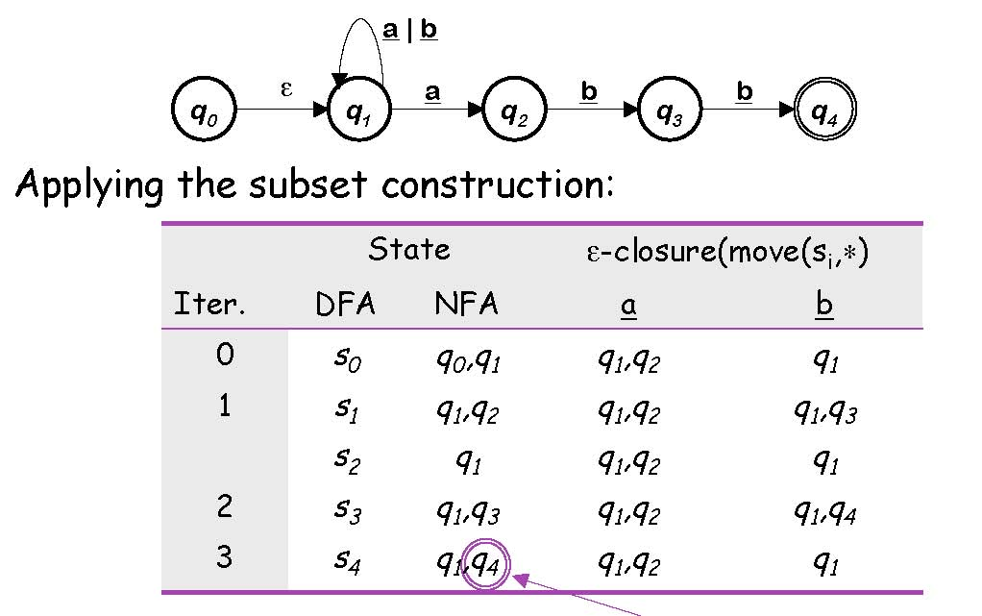
DFA Minimization : Example
NFA for (a | b)*abb

Slide 48
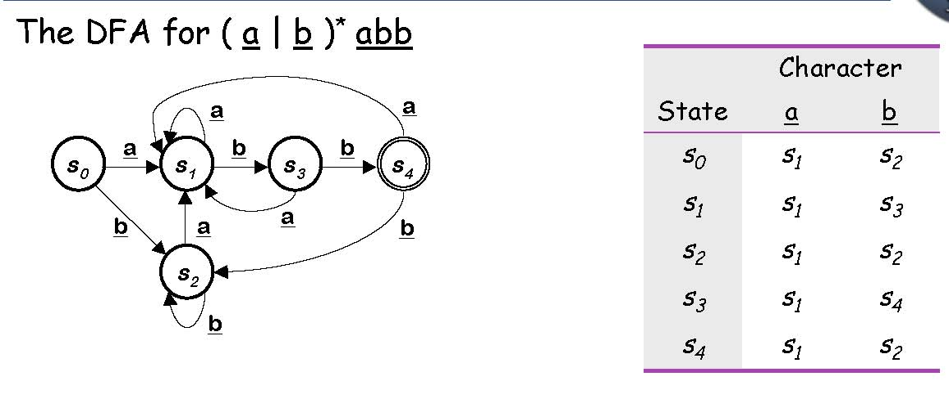
DFA Minimization : Example

Slide 49
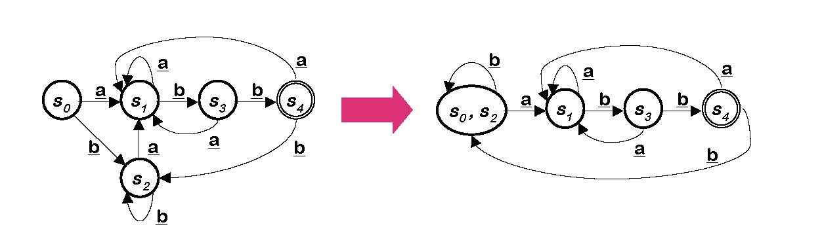
DFA Minimization : Example
 | Current Partition | p_{i} | Split on a | Split on b
P₀ | {s4} {s0,s1,s2,s3} | {s4} | none | None

Slide 50
DFA Minimization : Example
 | Current Partition | p_{i} | Split on a | Split on b
P₀ | {s4} {s0,s1,s2,s3} | {s4} | none | None
P₀ | {s4} {s0,s1,s2,s3} | {s0,s1,s2,s3} | none | {s0,s1,s2} {s3}

Slide 51
DFA Minimization : Example
 | Current Partition | p_{i} | Split on a | Split on b
P₀ | {s4} {s0,s1,s2,s3} | {s4} | none | None
P₀ | {s4} {s0,s1,s2,s3} | {s0,s1,s2,s3} | none | {s0,s1,s2} {s3}
P₁ | {s4} {s0,s1,s2} {s3} | {s0,s1,s2} | none | {s0,s2} {s1}

Slide 52
DFA Minimization : Example
 | Current Partition | p_{i} | Split on a | Split on b
P₀ | {s4} {s0,s1,s2,s3} | {s4} | none | none
P₀ | {s4} {s0,s1,s2,s3} | {s0,s1,s2,s3} | none | {s0,s1,s2} {s3}
P₁ | {s4} {s0,s1,s2} {s3} | {s0,s1,s2} | none | {s0,s2} {s1}
P₂ | {s4} {s0,s2} {s1} {s3} | {s0,s2} | none | none

Slide 53
DFA Minimization : Example
 | Current Partition | p_{i} | Split on a | Split on b
P₀ | {s4} {s0,s1,s2,s3} | {s4} | none | none
P₀ | {s4} {s0,s1,s2,s3} | {s0,s1,s2,s3} | none | {s0,s1,s2} {s3}
P₁ | {s4} {s0,s1,s2} {s3} | {s0,s1,s2} | none | {s0,s2} {s1}
P₂ | {s4} {s0,s2} {s1} {s3} | {s0,s1} | none | none

Slide 54
Another Example : RE to NFA a(b|c)*
Step 1: Compute trivial NFAs
a
s0
s1
b
s0
s1
c
s0
s1

Slide 55
Another Example : RE to NFA a(b|c)*
Step 2: Work inside parentheses b | c
b
s0
s1
s0
s5
c
s0
s1

Slide 56
Another Example : RE to NFA a(b|c)*
Step 2: Work inside parentheses b | c
b
s1
s3
s0
s5
c
s2
s4

Slide 57
Another Example : RE to NFA a(b|c)*
Step 3: * (closure)
b
s1
s3
s0
s0
s5
s5
c
s2
s4

Slide 58
Another Example : RE to NFA a(b|c)*
Step 3: * (closure)
b
s2
s4
s0
s1
s6
s7
c
s3
s5

Slide 59
Another Example : RE to NFA a(b|c)*
Step 4: concatenation
b
s4
s5
a
s0
s1
s2
s3
s8
s9
c
s6
s7

Slide 60
b
q4
q5
a
q0
q1
q2
q3
q8
q9
c
q6
q7
States |  | ε-closure(move(s,*))
DFA | NFA | a | b | c
s0 | q0

Slide 61
b
q4
q5
a
q0
q1
q2
q3
q8
q9
c
q6
q7
States |  | ε-closure(move(s,*))
DFA | NFA | a | b | c
s0 | q0 | q1, q2, q3 q4, q6, q9 | none | none
s1 | q1, q2, q3 q4, q6, q9

Slide 62
b
q4
q5
a
q0
q1
q2
q3
q8
q9
c
q6
q7
States |  | ε-closure(move(s,*))
DFA | NFA | a | b | c
s0 | q0 | q1, q2, q3 q4, q6, q9 | none | none
s1 | q1, q2, q3 q4, q6, q9 | none | q5, q8, q9 q3, q4, q6 | q7, q8, q9 q3, q4, q6

Slide 63
b
q4
q5
a
q0
q1
q2
q3
q8
q9
c
q6
q7
States |  | ε-closure(move(s,*))
DFA | NFA | a | b | c
s0 | q0 | q1, q2, q3 q4, q6, q9 | none | none
s1 | q1, q2, q3 q4, q6, q9 | none | q5, q8, q9 q3, q4, q6 | q7, q8, q9 q3, q4, q6

Slide 64
b
q4
q5
a
q0
q1
q2
q3
q8
q9
c
q6
q7
States |  | ε-closure(move(s,*))
DFA | NFA | a | b | c
s0 | q0 | q1, q2, q3 q4, q6, q9 | none | none
s1 | q1, q2, q3 q4, q6, q9 | none | q5, q8, q9 q3, q4, q6 | q7, q8, q9 q3, q4, q6
s2 | q5, q8, q9 q3, q4, q6
s3 | q7, q8, q9 q3, q4, q6

Slide 65
b
q4
q5
a
q0
q1
q2
q3
q8
q9
c
q6
q7
States |  | ε-closure(move(s,*))
DFA | NFA | a | b | c
s0 | q0 | q1, q2, q3 q4, q6, q9 | none | none
s1 | q1, q2, q3 q4, q6, q9 | none | q5, q8, q9 q3, q4, q6 | q7, q8, q9 q3, q4, q6
s2 | q5, q8, q9 q3, q4, q6 | none | q5, q8, q9 q3, q4, q6 | q7, q8, q9 q3, q4, q6
s3 | q7, q8, q9 q3, q4, q6

Slide 66
b
q4
q5
a
q0
q1
q2
q3
q8
q9
c
q6
q7
States |  | ε-closure(move(s,*))
DFA | NFA | a | b | c
s0 | q0 | q1, q2, q3 q4, q6, q9 | none | none
s1 | q1, q2, q3 q4, q6, q9 | none | q5, q8, q9 q3, q4, q6 | q7, q8, q9 q3, q4, q6
s2 | q5, q8, q9 q3, q4, q6 | none | q5, q8, q9 q3, q4, q6 | q7, q8, q9 q3, q4, q6
s3 | q7, q8, q9 q3, q4, q6 | none | q5, q8, q9 q3, q4, q6 | q7, q8, q9 q3, q4, q6

Slide 67
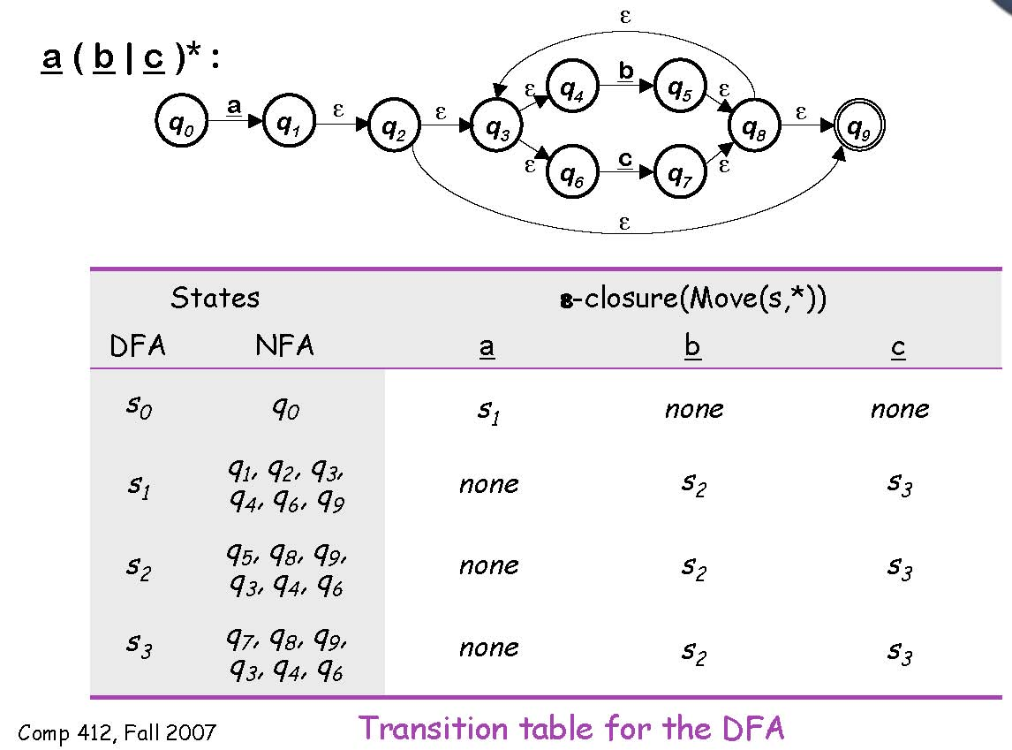
NFA→DFA with Subset Construction

Slide 68
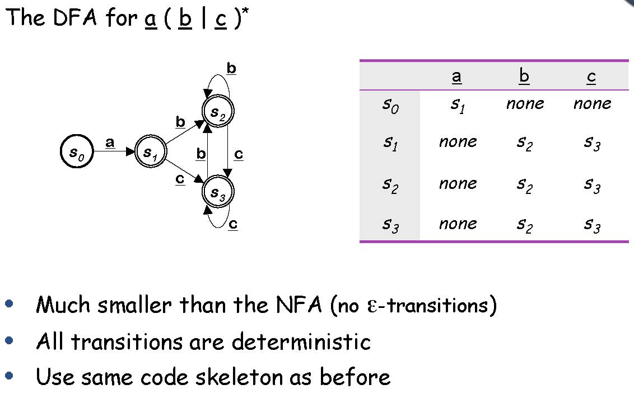
NFA→DFA with Subset Construction

